Slide 1

Use case Driven Object Oriented Analysis: The Unified Approach
Identify the actors:
Who is using the system? *.
Or, in the case of a new system, who will be using the system?
2. Develop a simple business process model using UML activity diagram.
3. Develop the use case: .
What are the users doing with the system?.
Or, in case of the new system, what will users be doing with the system?
Use cases provide us with comprehensive documentation of the system under study.
4.Prepare interaction diagrams:*. Determine the sequence.
Develop collaboration diagrams.
5. Classification -develop a static UML class diagram:
Identify classes.
Identify relationships.
Identify attributes.
Identify methods.
6. Iterate and refine: If needed, repeat the preceding steps

Slide 2


Slide 3
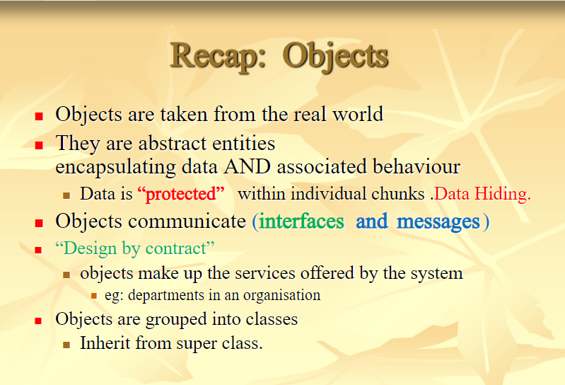

Slide 4
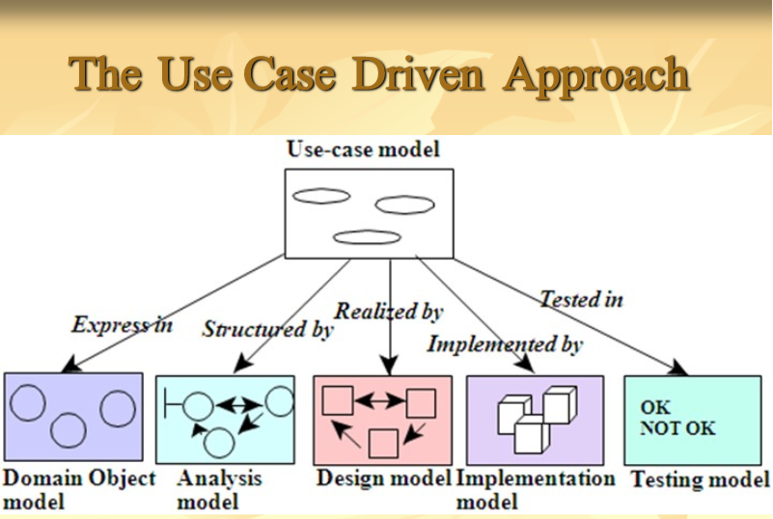

Slide 5
Object Analysis : classification
Classification is a process of checking to see if an object belongs to a category.
Classification is to identify the class of an object.
Class is a conceptual building blocks for designing.
Classification defined as the categorization of input data (things) into identifiable classes.

Slide 6
Approaches for identifying classes
Noun phrase approach
Common class pattern approach
Use case driven sequence / collaboration modeling approach
Classes, Responsibilities and collaborators (CRC) approach
First two approaches increase the understanding.
Unified approach uses the use case driven for identifying classes behavior.
CRC – for identifying classes responsibilities.

Slide 7
1. Noun Phrase approach
Looking for noun phrases from use cases.
Noun is defined as classes.
Verbs to be method of the classes.
All plurals changed into singular.
The nouns are listed and divided into three categories.
Relevant classes.
Fuzzy classes.
Irrelevant classes.
Scrap the irrelevant classes.
Identifying classes and developing UML class diagram is an iterative process.

Slide 8
Noun Phrase approach
Identifying tentative classes.
Look for nouns and noun phrases in the use cases.
Some classes are implicit or taken from general knowledge.
All classes make sense in the application domain.
Carefully chose and define class names.

Slide 9
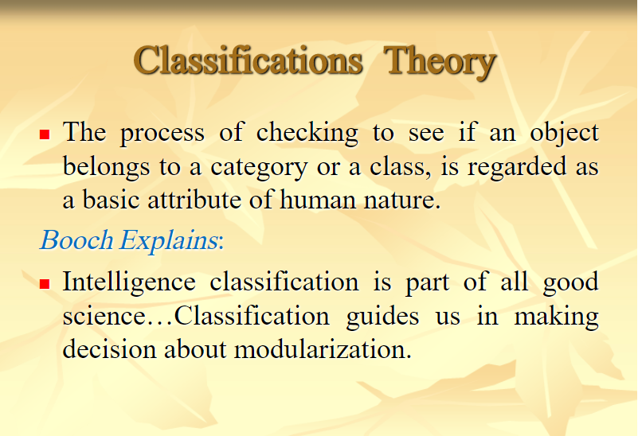

Slide 10
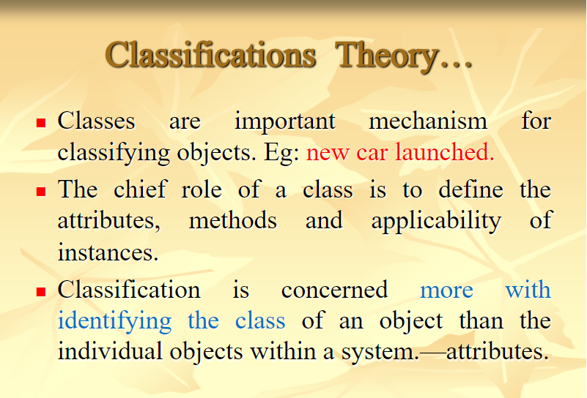

Slide 11
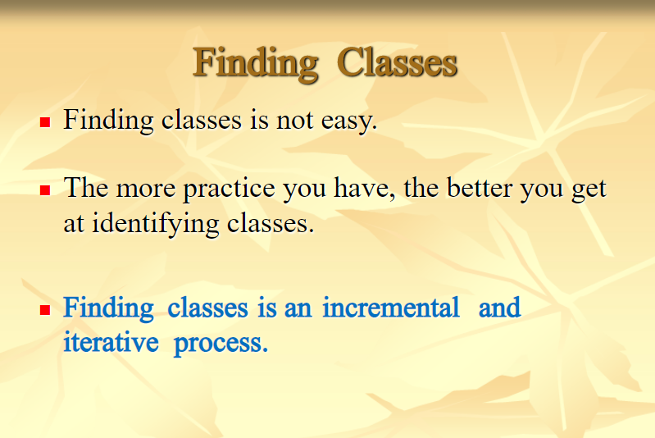

Slide 12
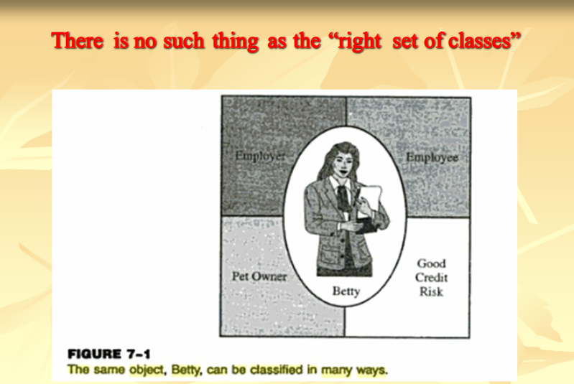

Slide 13
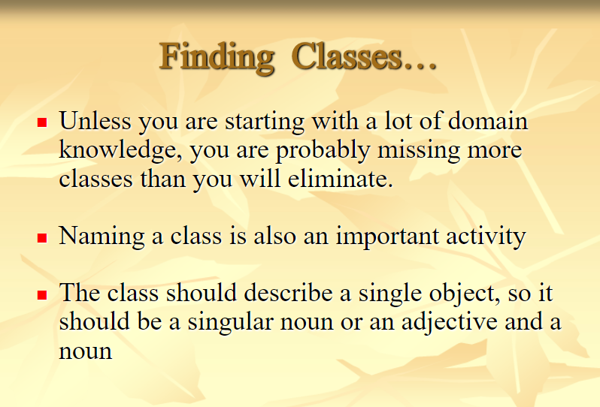

Slide 14
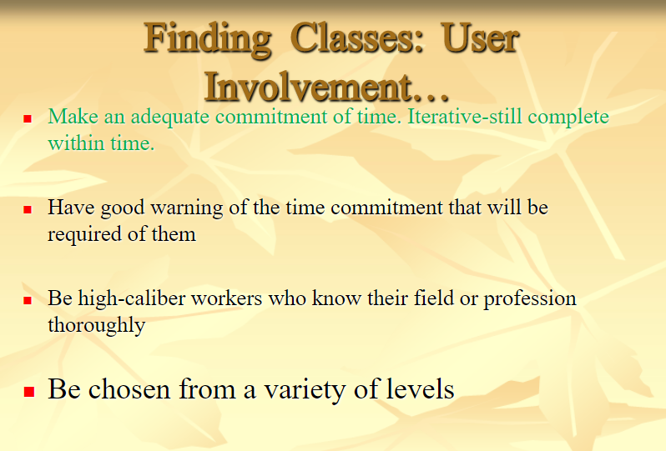

Slide 15
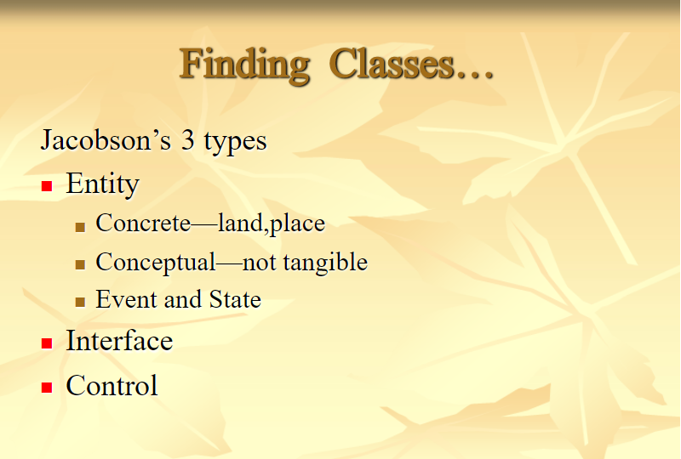

Slide 16
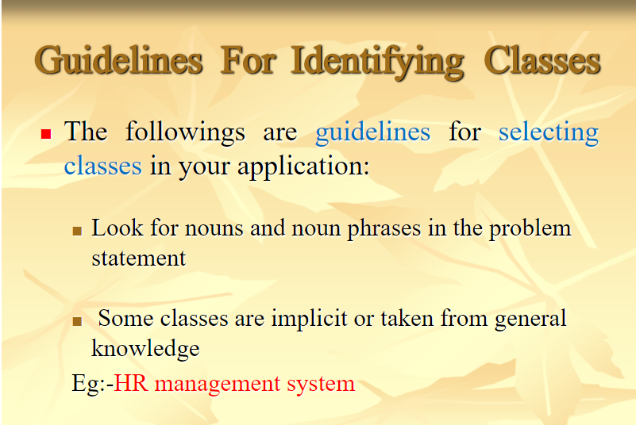

Slide 17
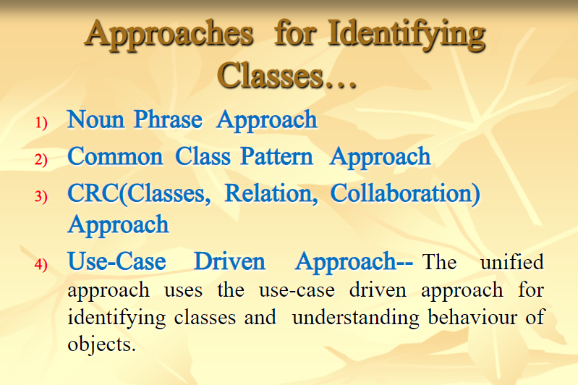

Slide 18
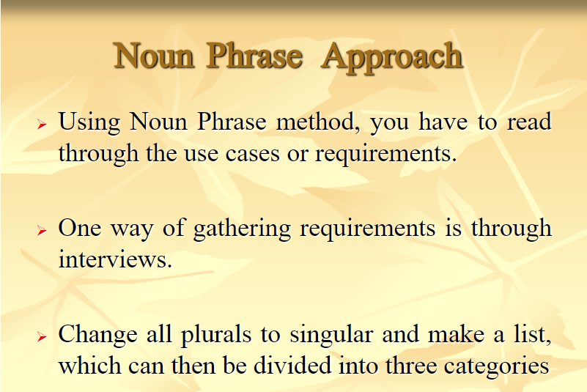

Slide 19
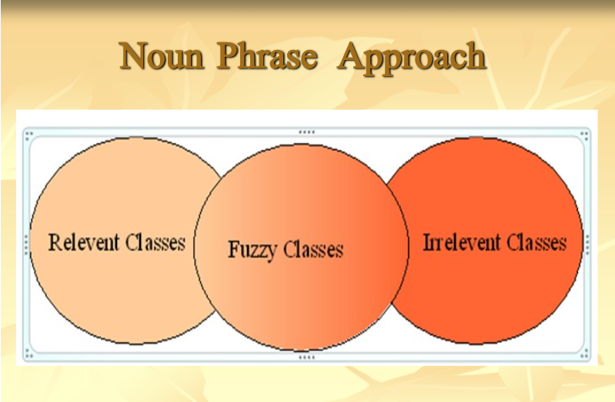

Slide 20
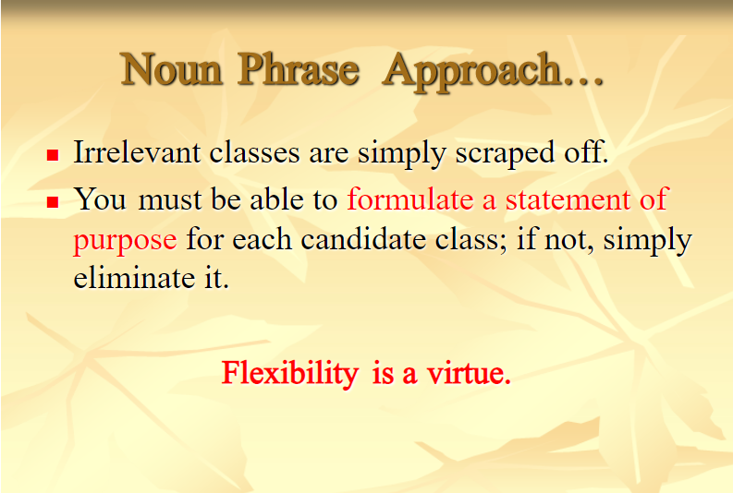

Slide 21
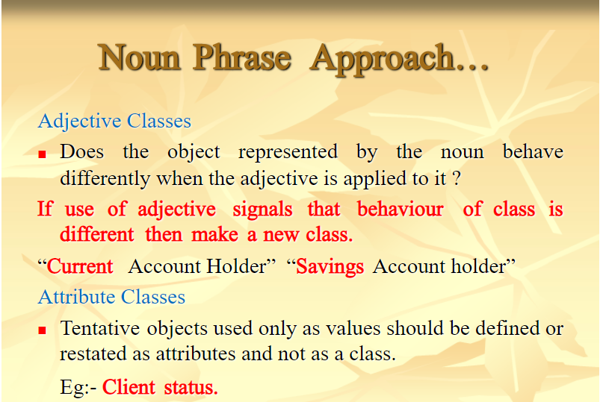

Slide 22
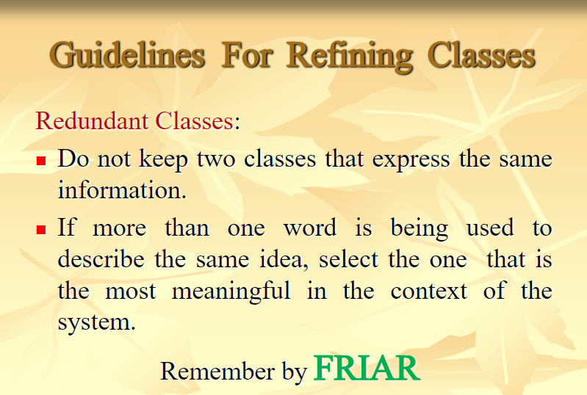

Slide 23
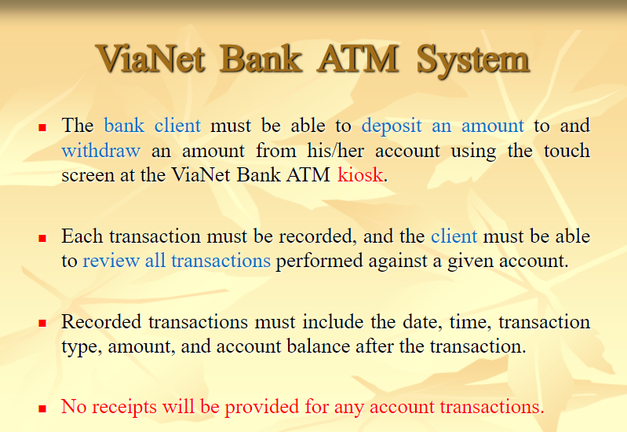

Slide 24
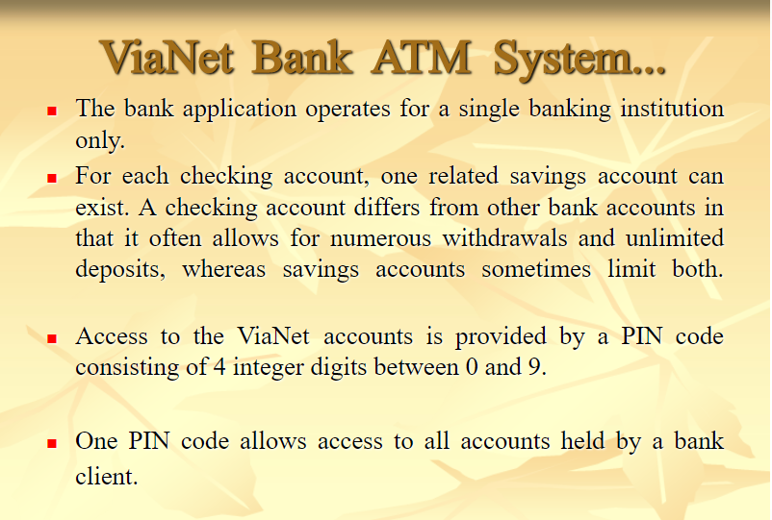

Slide 25
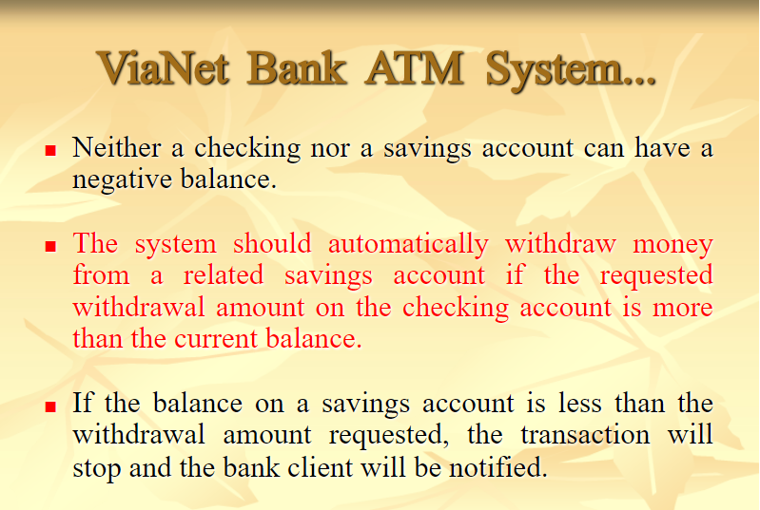

Slide 26
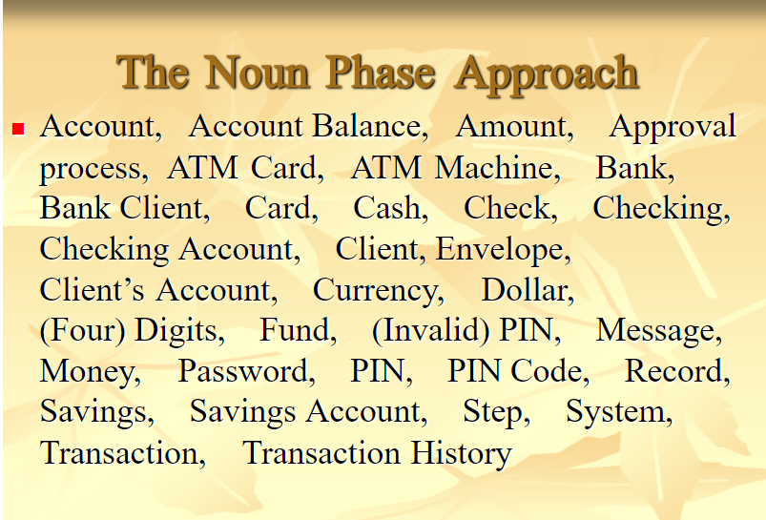

Slide 27
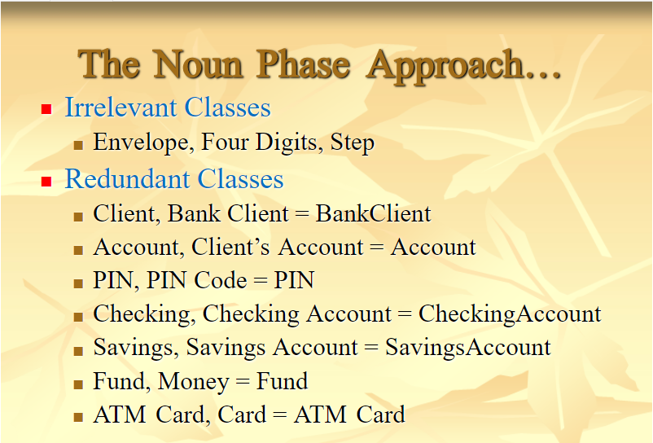

Slide 28
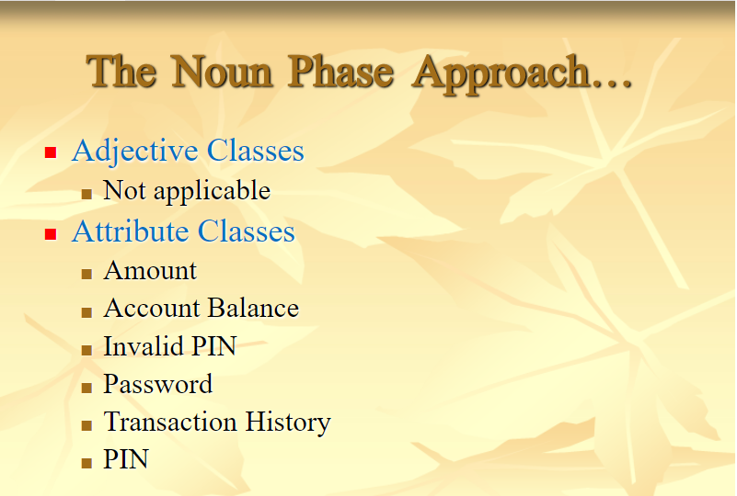

Slide 29
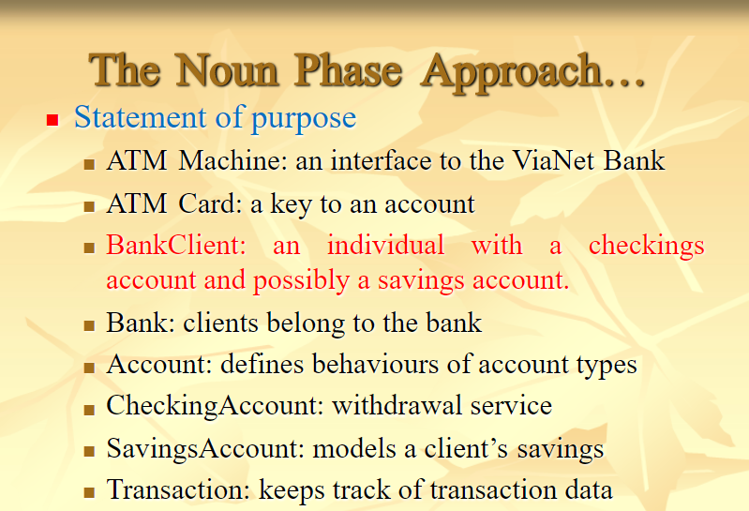

Slide 30
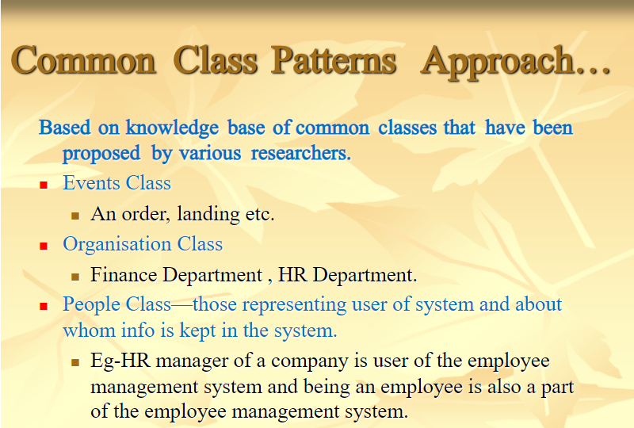

Slide 31
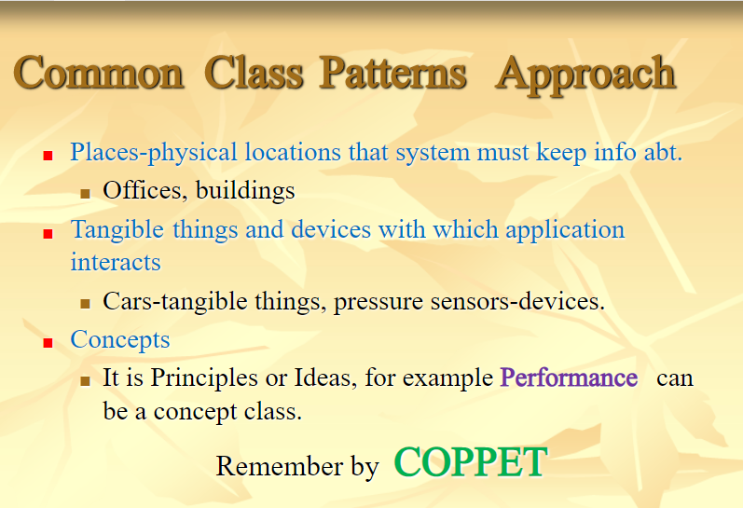

Slide 32
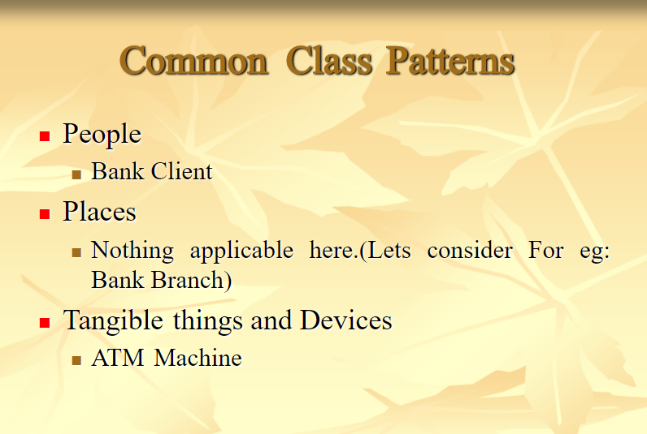

Slide 33
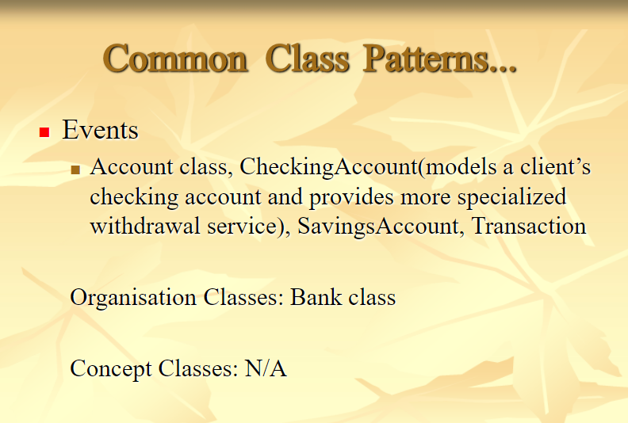

Slide 34
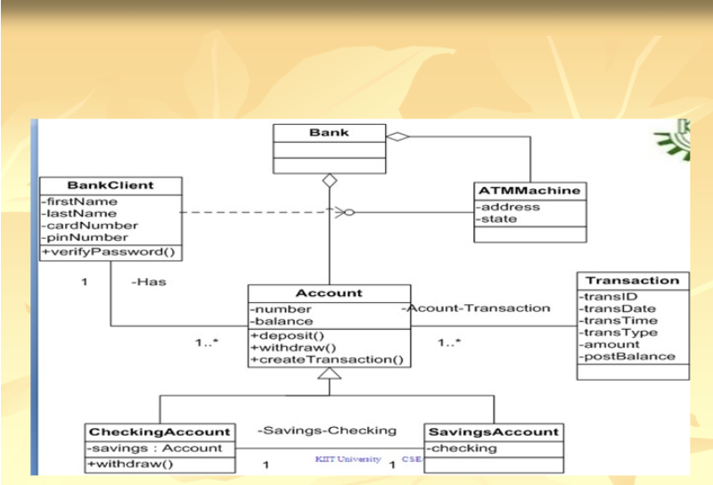

Slide 35
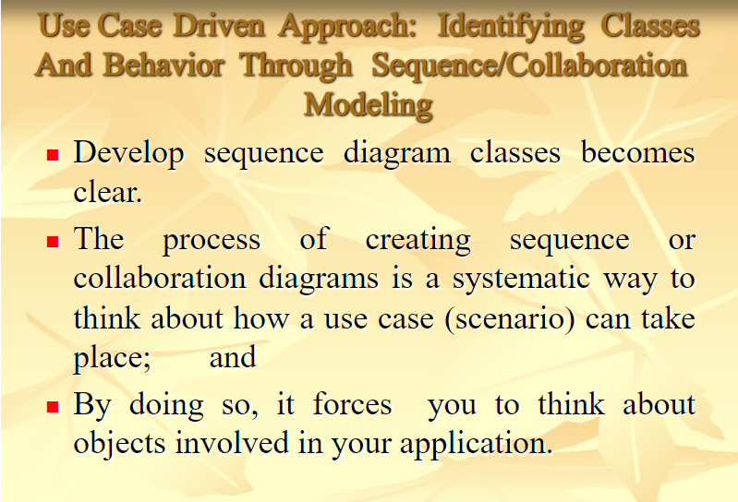

Slide 36
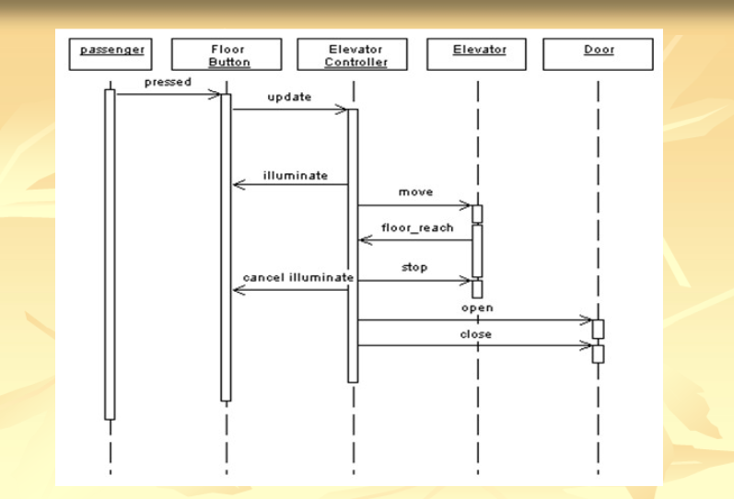

Slide 37
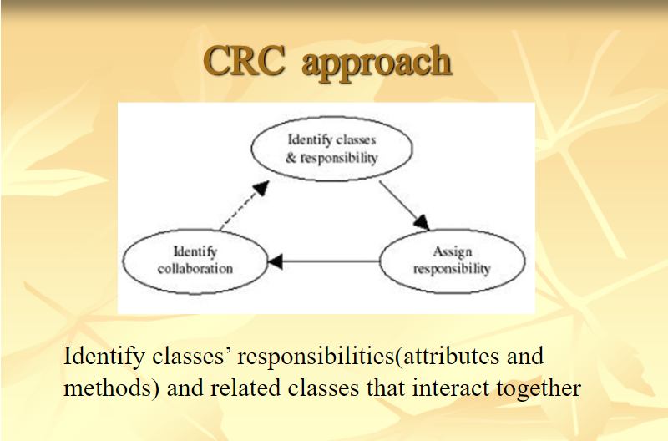

Slide 38
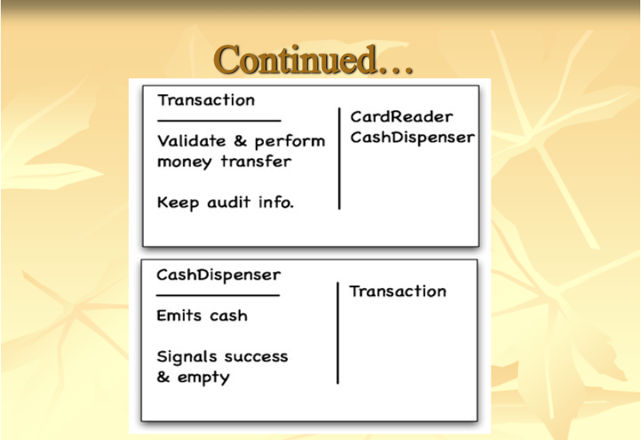

Slide 39
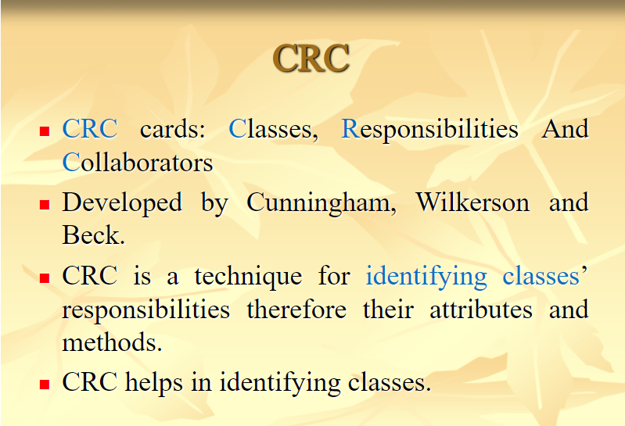

Slide 40
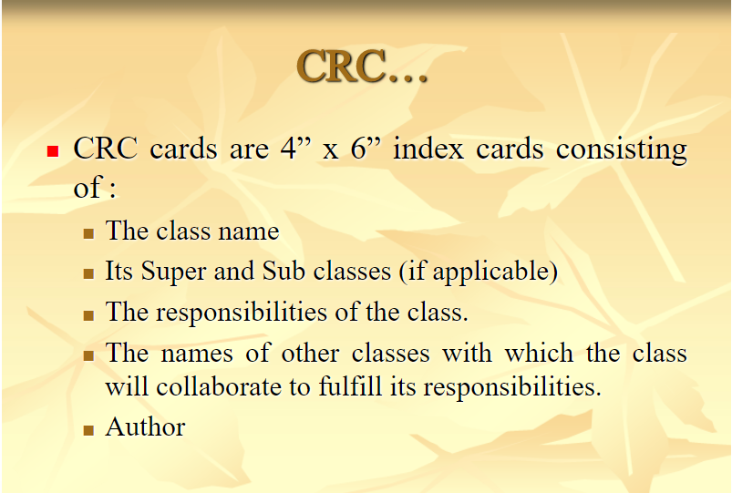

Slide 41
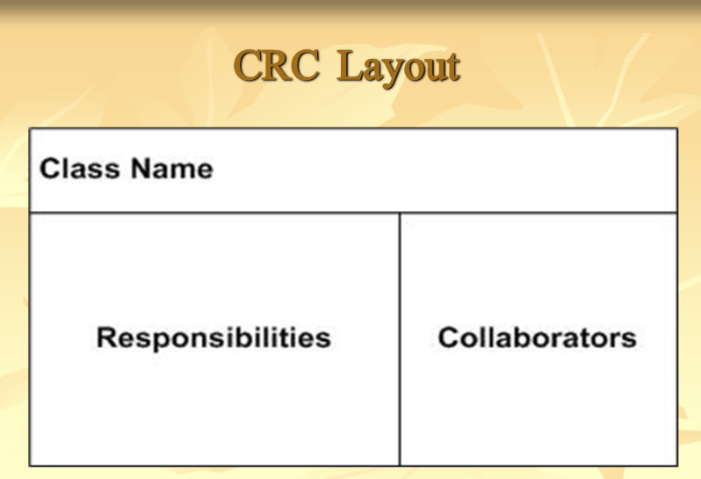

Slide 42
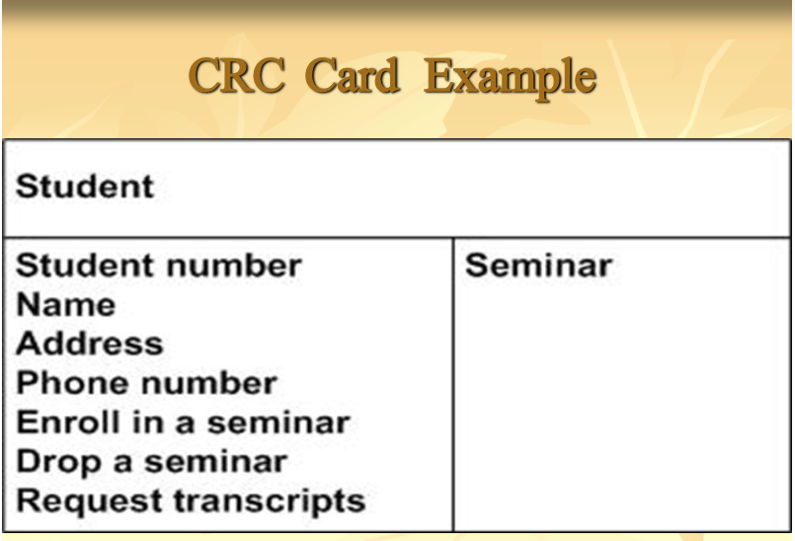

Slide 43
